Slide 1
BLUESTOCK
MUTUAL FUND ANALYTICS
End-to-End Data Engineering • Financial Analytics • Power BI
Final Project Presentation
SCHEMES
NAV RECORDS
TRANSACTIONS
40
46K
32.8K

Slide 2
BLUESTOCK MUTUAL FUND ANALYTICS
2
Project Objective
Turn fragmented mutual-fund data into one reliable analytical product.
THE BUSINESS QUESTION
WHAT THE PROJECT DELIVERS
• Which funds deliver stronger returns for the risk taken?
• How are SIP, AUM, folio and category flows changing?
• How does fund performance compare with market benchmarks?
• Can investors compare funds through an interactive dashboard?
• Can quantitative metrics support transparent fund ranking?
• Reusable Python ETL pipeline with validation
• SQLite / SQL analytical storage
• EDA and financial performance notebooks
• Risk-return and benchmark analysis
• Four-page Power BI dashboard + drill-through
• Rule-based fund recommender
Bluestock Mutual Fund Analytics • Final Project

Slide 3
BLUESTOCK MUTUAL FUND ANALYTICS
3
Solution Architecture
A pipeline that moves from raw financial data to decision-ready insights.
01
02
03
04
05
06
RAW DATA
ETL
STORAGE
ANALYTICS
DECISION
REPORTING
CSV • MFAPI
Python • Pandas
SQLite • SQL
Jupyter • NumPy
Recommender
Power BI
Raw NAV, fund, AUM, SIP, transaction & benchmark data
Cleaning, standardization, date/NAV validation
Relational tables, queries & structured access
EDA, CAGR, Sharpe, Beta, VaR & drawdown
Risk-profile scoring & fund ranking
Interactive pages, slicers & drill-through
Bluestock Mutual Fund Analytics • Final Project

Slide 4
BLUESTOCK MUTUAL FUND ANALYTICS
4
Data Ecosystem
10 complementary datasets create the analytical backbone.
Fund Master
40
NAV History
46,000
Scheme metadata
Historical NAV
AUM by Fund House
90
Monthly SIP
48
AUM trend
SIP inflows
Category Inflows
144
Industry Folios
21
Category flows
Folio trend
Performance
40
Transactions
32,778
Return & risk
Investor behaviour
Holdings
322
Benchmarks
8,050
Stock/sector exposure
Market comparison
Bluestock Mutual Fund Analytics • Final Project

Slide 5
BLUESTOCK MUTUAL FUND ANALYTICS
5
ETL Pipeline & Data Quality
Designed for repeatability, financial-date correctness and validation.
EXTRACT
TRANSFORM
NAV HANDLING
VALIDATE
• Load raw CSVs
• Live NAV retrieval
• Source-file checks
• Standardize columns
• Remove duplicates
• Convert dates & values
• Daily calendar reindex
• Forward-fill weekends/holidays
• Reject non-positive NAV
• Missing columns/values
• Infinite numeric checks
• AMFI code + date uniqueness
KEY ENGINEERING PRINCIPLE
Project-relative paths via pathlib • no hard-coded machine paths • explicit validation before analytics
Bluestock Mutual Fund Analytics • Final Project

Slide 6
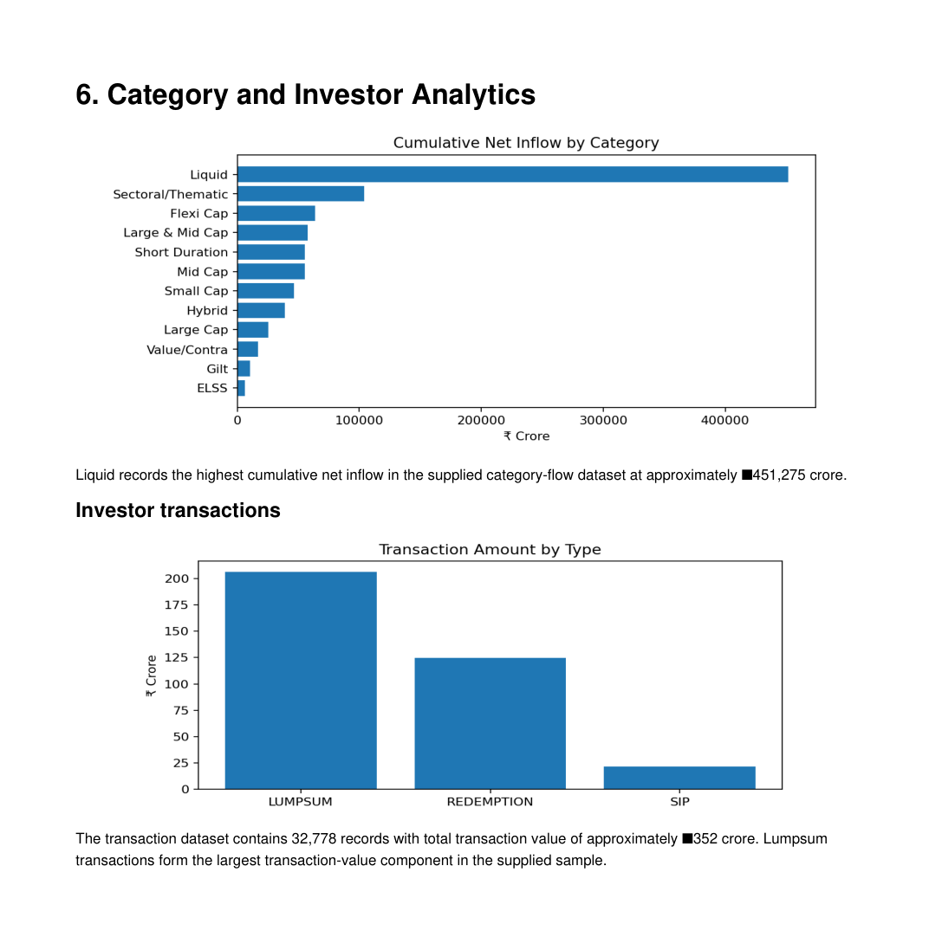
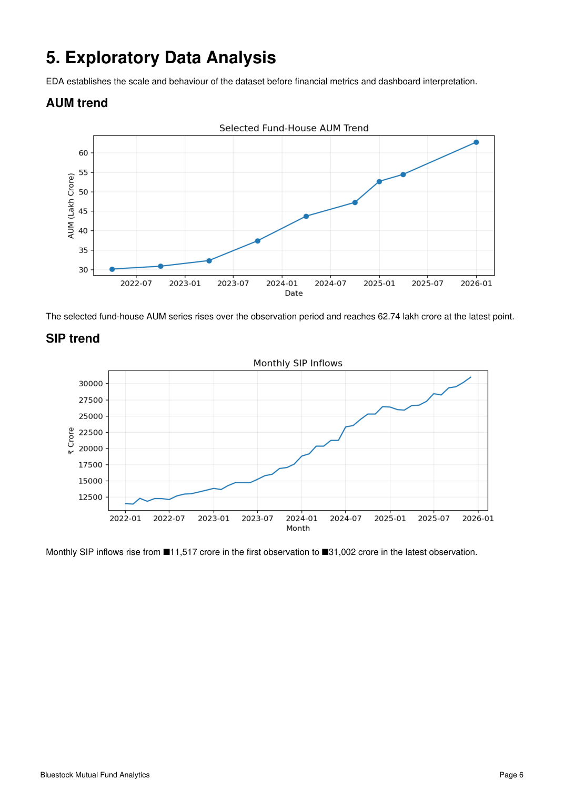
BLUESTOCK MUTUAL FUND ANALYTICS
6
Exploratory Data Analysis
Industry scale and investor-flow trends establish the context before fund-level scoring.
AUM + SIP trend
Category inflows + transactions
Bluestock Mutual Fund Analytics • Final Project

Slide 7
BLUESTOCK MUTUAL FUND ANALYTICS
7
Financial Performance Metrics
Returns are evaluated alongside risk, not in isolation.
1Y Return
3Y Return
5Y Return
Volatility
14.38%
14.09%
14.52%
14.96%
Average
Average
Average
Annualized
Sharpe
Beta
Max Drawdown
Risk-free rate
1.36
0.87
-19.20%
6.5%
Average
Average
Average
Used for Sharpe
FORMULA LAYER
Daily Return
CAGR
Sharpe
Beta
NAVₜ / NAVₜ₋₁ − 1
(End / Start)^(1/n) − 1
(Rp − Rf) / σ × √252
Cov(Rp,Rm) / Var(Rm)
Bluestock Mutual Fund Analytics • Final Project

Slide 8
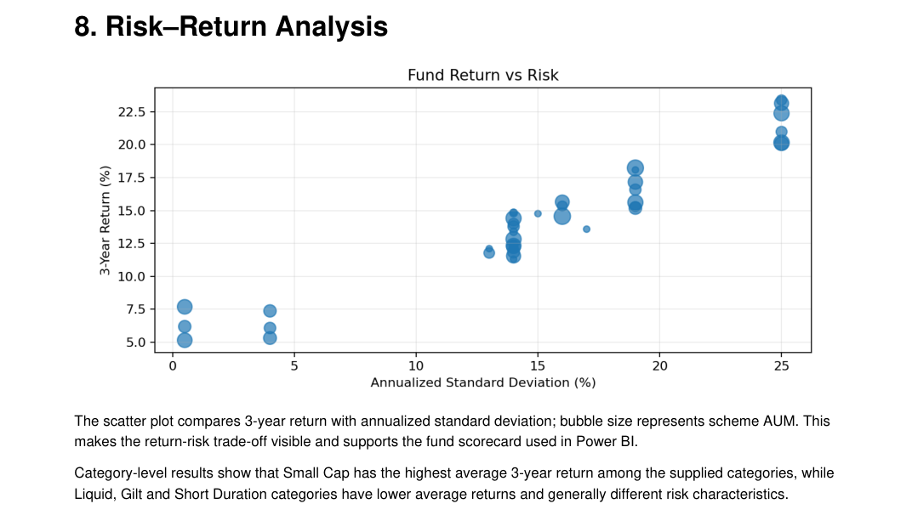
BLUESTOCK MUTUAL FUND ANALYTICS
8
Risk–Return Analysis
The sweet spot is not simply the fund with the tallest return bar.
HIGHEST 3-YEAR RETURN
23.39%
SBI Small Cap Fund – Regular Plan – Growth
HIGHEST SHARPE
7.68
ICICI Pru Liquid Fund – Regular – Growth
HIGHEST ALPHA
1.98%
HDFC Short Term Debt Fund – Regular – Growth
Bluestock Mutual Fund Analytics • Final Project

Slide 9
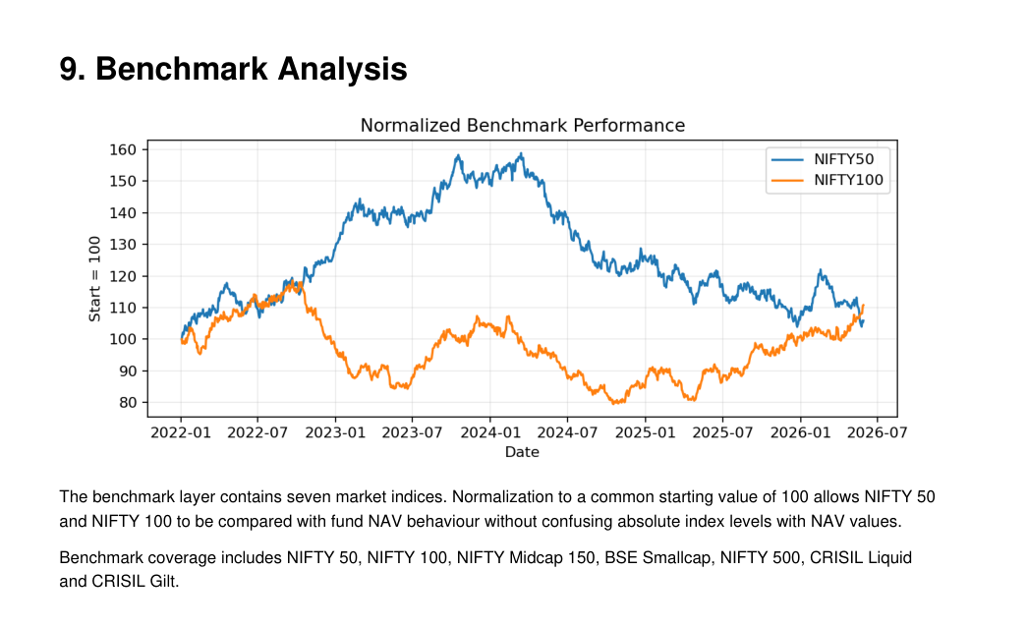
BLUESTOCK MUTUAL FUND ANALYTICS
9
Benchmark Analysis
Normalize different index levels to a common starting point of 100.
BENCHMARK COVERAGE
• NIFTY 50
• NIFTY 100
• NIFTY Midcap 150
• BSE Smallcap
• NIFTY 500
• CRISIL Liquid
• CRISIL Gilt
WHY NORMALIZE?
It lets fund NAV growth and benchmark growth be
compared on the same visual scale.
Bluestock Mutual Fund Analytics • Final Project

Slide 10
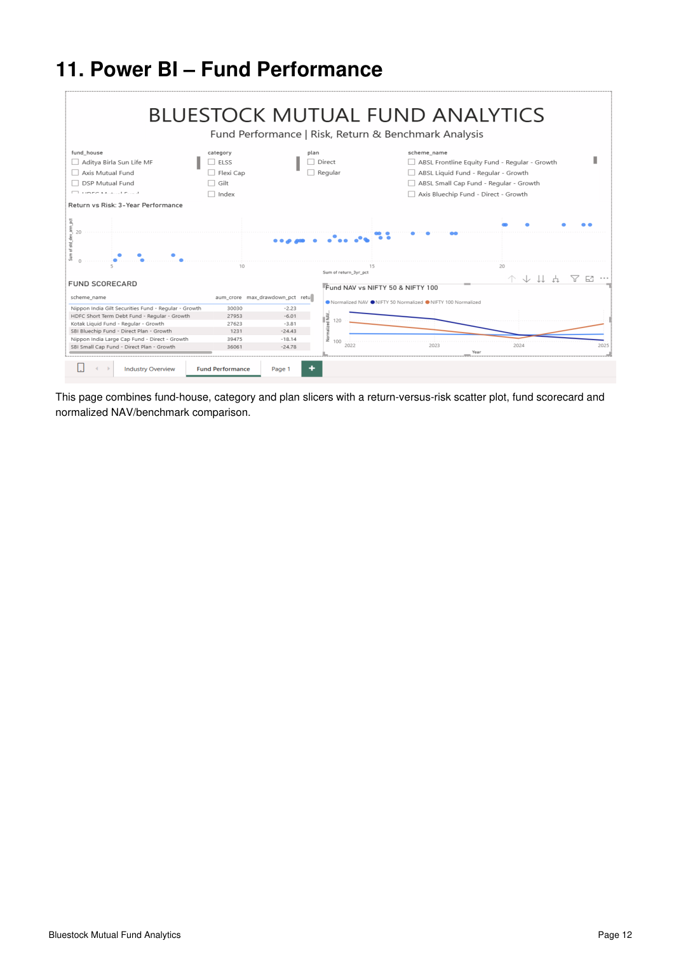
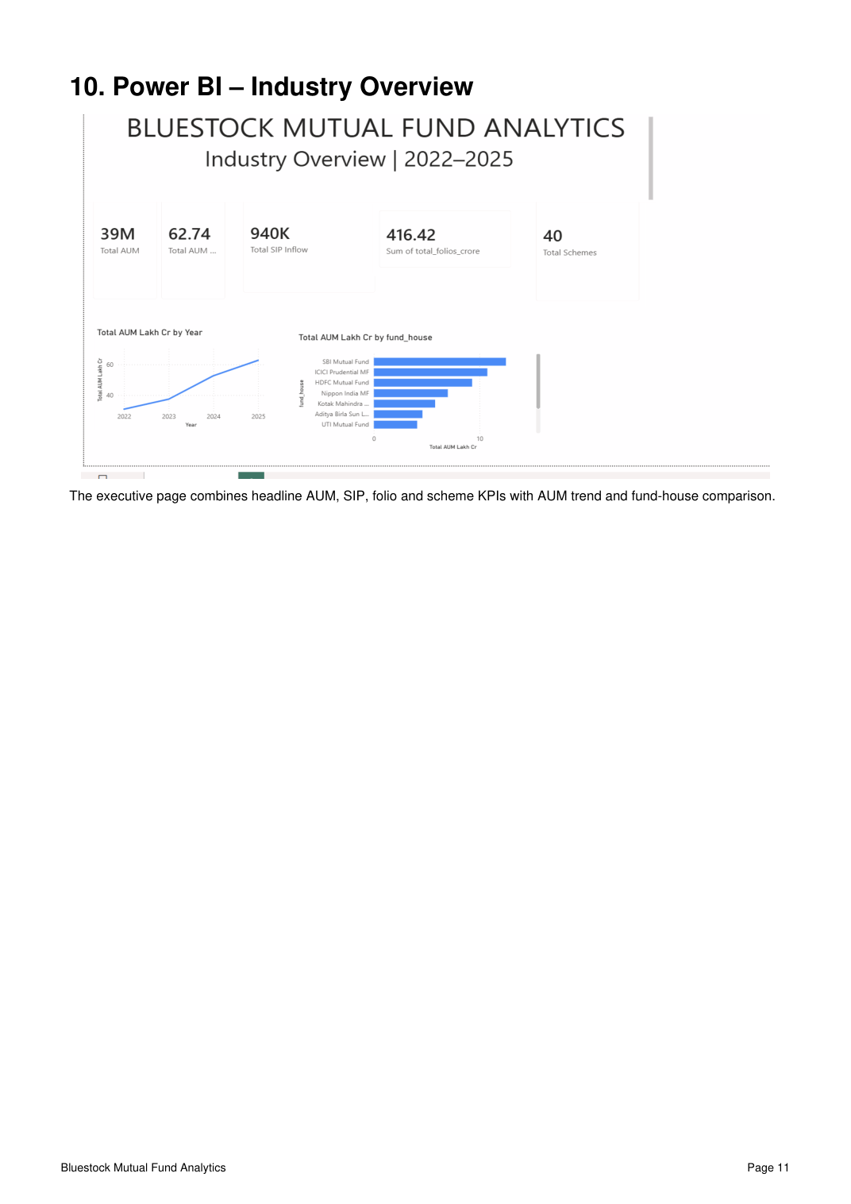
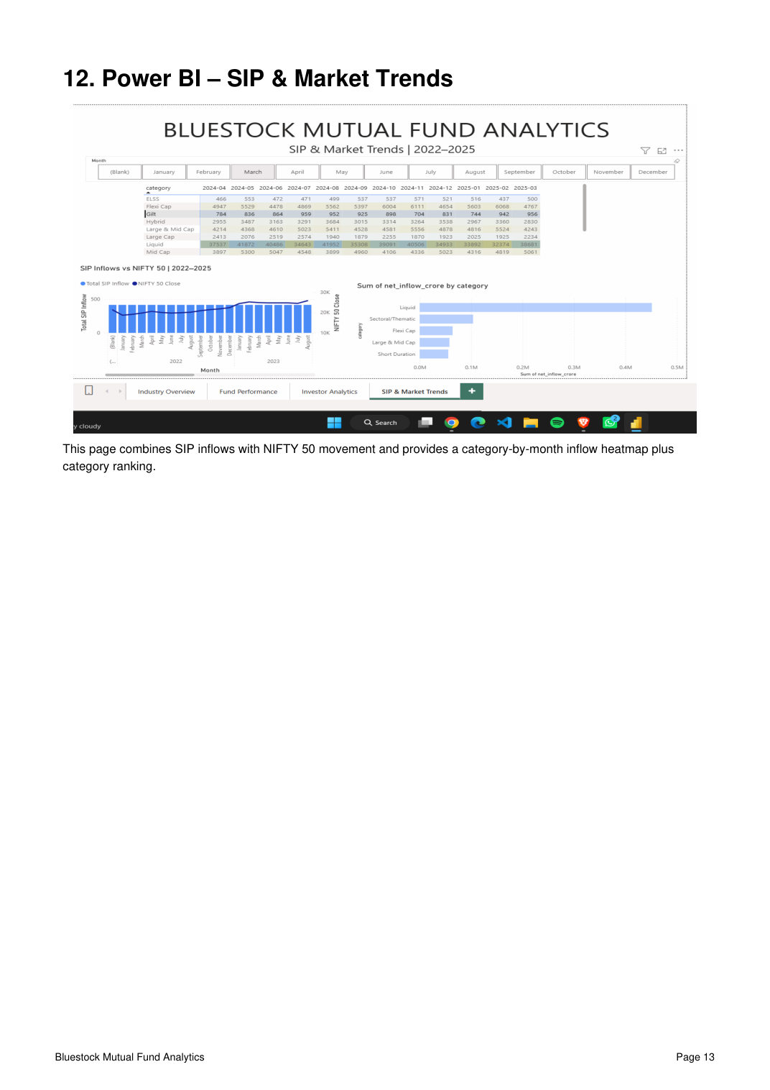
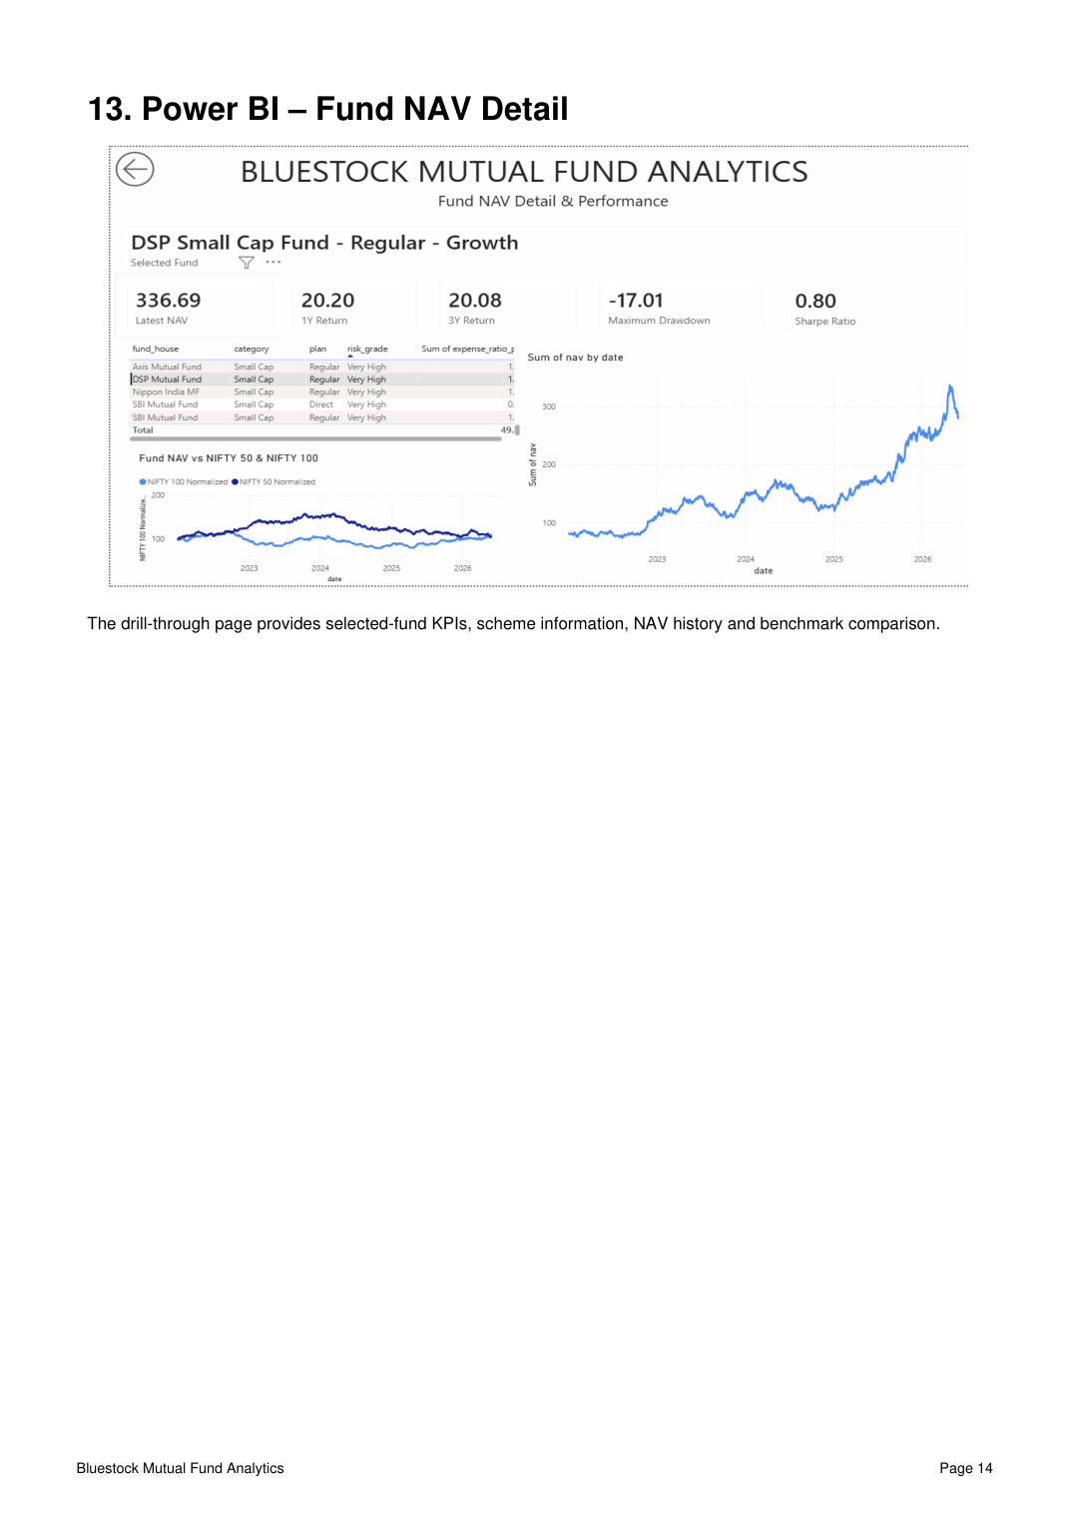
BLUESTOCK MUTUAL FUND ANALYTICS
10
Power BI Dashboard
Four pages turn the analytical layer into an interactive decision tool.
01 • Industry Overview
02 • Fund Performance
03 • SIP & Market Trends
04 • Fund NAV Detail
Bluestock Mutual Fund Analytics • Final Project

Slide 11
BLUESTOCK MUTUAL FUND ANALYTICS
11
Dashboard Page 2 • Fund Performance
Interactive filters + risk-return scatter + scorecard + benchmark comparison.
INTERACTIVE CONTROLS
• Fund house
• Category
• Plan
• Scheme name
ANALYTICAL VIEWS
• 3-year return vs risk
• Fund scorecard
• Normalized NAV vs NIFTY 50 / 100
Bluestock Mutual Fund Analytics • Final Project

Slide 12
BLUESTOCK MUTUAL FUND ANALYTICS
12
Dashboard Page 3 • SIP & Market Trends
A monthly heatmap and market overlay reveal flow patterns at a glance.
LATEST SIP INFLOW
₹31,002 Cr
Latest observation in supplied data
TOP CATEGORY FLOW
Liquid
Highest cumulative net inflow
MARKET OVERLAY
NIFTY 50
Compared alongside SIP inflow
Bluestock Mutual Fund Analytics • Final Project

Slide 13
BLUESTOCK MUTUAL FUND ANALYTICS
13
Dashboard Page 4 • Fund NAV Detail
Drill-through converts a portfolio-level dashboard into a single-fund investigation workspace.
SELECTED FUND EXAMPLE
DSP Small Cap Fund Regular – Growth
• Latest NAV: 336.69
• 1Y Return: 20.20%
• 3Y Return: 20.08%
• Maximum Drawdown: -17.01%
• Sharpe Ratio: 0.80
• NAV history + benchmark view
Bluestock Mutual Fund Analytics • Final Project

Slide 14
BLUESTOCK MUTUAL FUND ANALYTICS
14
Advanced Analytics • Fund Recommender
A transparent scoring system rather than a black-box recommendation.
CONSERVATIVE
MODERATE
AGGRESSIVE
Sharpe • Volatility • Drawdown
Balanced return + risk-adjusted performance
Return • Market exposure
SCORING DIMENSIONS
OUTPUT
• 3-year return / CAGR
• Sharpe Ratio
• Annualized volatility
• Maximum drawdown
• Beta proximity to 1
RANKED FUND SIGNALS
Strong Buy • Buy • Hold • Watch • Avoid Designed for analytical comparison, not personalized investment advice.
Bluestock Mutual Fund Analytics • Final Project

Slide 15
BLUESTOCK MUTUAL FUND ANALYTICS
15
Key Findings
What the data says after the pipeline, analytics and dashboard layers are connected.

Slide 16
BLUESTOCK MUTUAL FUND ANALYTICS
16
Deliverables & Completion Map
The presentation maps directly to the seven graded project deliverables.
ID
DELIVERABLE
PROJECT OUTPUT
WEIGHT
D1
ETL Pipeline
Python ingestion, transformation & validation
15%
D2
SQLite Database
Relational storage & SQL analysis
10%
D3
EDA Notebook
Exploration, charts & documented insights
15%
D4
Performance Metrics
CAGR, Sharpe, Beta, VaR & risk
15%
D5
Interactive Dashboard
4 Power BI pages + drill-through
20%
D6
Advanced Analytics
Fund recommendation scoring
10%
D7
Final Report
Professional documentation
15%
FUTURE / BONUS SCOPE
Scheduled ETL • Streamlit • Monte Carlo • Markowitz Efficient Frontier • Automated email report
Bluestock Mutual Fund Analytics • Final Project

Slide 17
CONCLUSION
Bluestock Mutual Fund Analytics connects raw financial data with quantitative analysis and interactive business reporting.
The final solution brings together data engineering, SQL, financial statistics, benchmark analysis and Power BI into one coherent analytical product.
DATA
ANALYTICS
DASHBOARD
DECISION
46K NAV observations
7 core risk/return metrics
4 interactive pages
Risk-profile recommender
Thank you

